Slide 1
RESTful Microservices from the Ground Up
Mike Amundsen API Academy @mamund

Slide 2
Agenda
9:00 - 9:45 : What are RESTful Microservices?
9:45 - 10:30 : Models, Messages, and Vocabularies
10:30 - 10:45 : BREAK
10:45 - 11:30 : Runtime Service Infrastructure
11:30 - 12:15 : The Adaptable System
12:15 - 12:30 : Summary

Slide 3
Materials
Laptop w/ wifi
NodeJS
Browser and cURL
Your favorite editor
Github and Heroku
Pen and Paper

Slide 4
What are RESTful Microservices?

Slide 5
What are RESTful Microservices?
Microservices
RESTful-ness
A New Kind of Service
Analysis Exercise

Slide 6
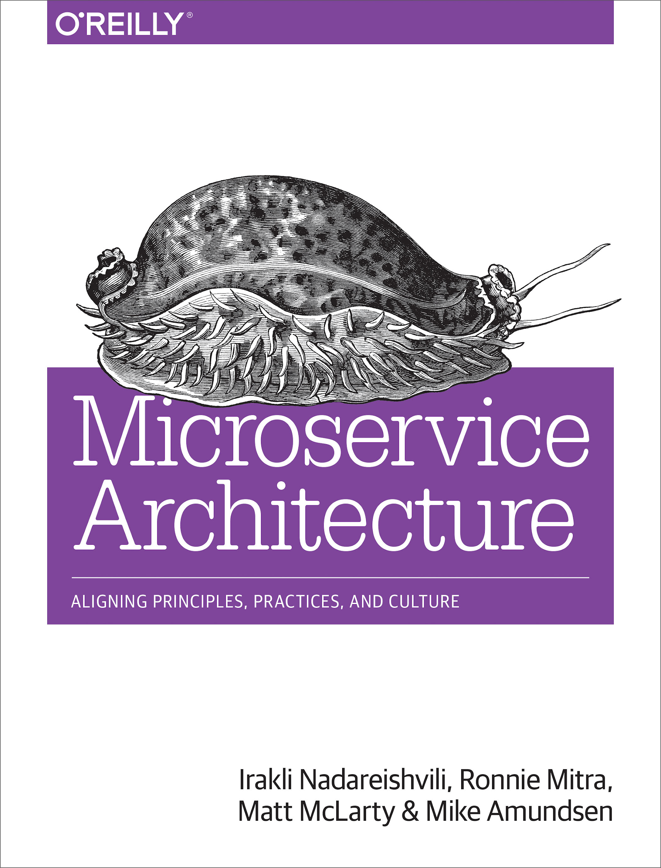
Microservices
"A microservice is an independently deployable component of bounded scope that supports interoperability through message-based communication. Microservice architecture is a style of engineering highly automated, evolvable software systems made up of capability-aligned microservices."

Slide 7
Microservices
"A microservice is an independently deployable component of bounded scope that supports interoperability through message-based communication. Microservice architecture is a style of engineering highly automated, evolvable software systems made up of capability-aligned microservices."

Slide 8
Microservices
"A microservice is an independently deployable component of bounded scope that supports interoperability through message-based communication. Microservice architecture is a style of engineering highly automated, evolvable software systems made up of capability-aligned microservices."

Slide 9
Microservices
"A microservice is an independently deployable component of bounded scope that supports interoperability through message-based communication. Microservice architecture is a style of engineering highly automated, evolvable software systems made up of capability-aligned microservices."

Slide 10
Microservices
"A microservice is an independently deployable component of bounded scope that supports interoperability through message-based communication. Microservice architecture is a style of engineering highly automated, evolvable software systems made up of capability-aligned microservices."

Slide 11
Microservices
"A microservice is an independently deployable component of bounded scope that supports interoperability through message-based communication. Microservice architecture is a style of engineering highly automated, evolvable software systems made up of capability-aligned microservices."

Slide 12
Microservices
Independently deployable
Bounded scope
Message-based
Highly automated
Evolvable

Slide 13
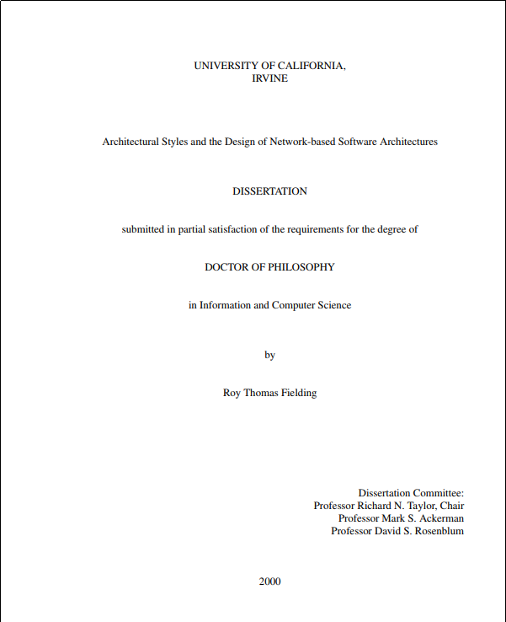
RESTful-ness
"This dissertation defines a framework for understanding software architecture via architectural styles and demonstrates how styles can be used to guide the architectural design of network-based application software."
- Fielding, 2000

Slide 14
RESTful-ness
"This dissertation defines a framework for understanding software architecture via architectural styles and demonstrates how styles can be used to guide the architectural design of network-based application software."
- Fielding, 2000

Slide 15
RESTful-ness
Properties
Performance
Scalability
Simplicity
Modifiability
Visibility
Portability
Reliability
Notes:
Client-Server: Induces portability, scalability. Internet Scale requirement
Stateless: Induces visibility, reliability, and scalability
Cache: Induces network efficiency (performance)
Uniform Interface: Induces simplicity, visibility, evolvability. SubConstraints: addressability, representations, self-descriptiveness, hypermedia to change state
Layered System: Induces: simplicity, scalability. Internet Scale requirement
Code On Demand: Induces extensibility (OPTIONAL)

Slide 16
RESTful-ness
Properties
Performance
Scalability
Simplicity
Modifiability
Visibility
Portability
Reliability
+ Requirements
Low-Entry Barrier
Extensibility
Distributed Hypermedia
Internet Scale
Notes:
Client-Server: Induces portability, scalability. Internet Scale requirement
Stateless: Induces visibility, reliability, and scalability
Cache: Induces network efficiency (performance)
Uniform Interface: Induces simplicity, visibility, evolvability. SubConstraints: addressability, representations, self-descriptiveness, hypermedia to change state
Layered System: Induces: simplicity, scalability. Internet Scale requirement
Code On Demand: Induces extensibility (OPTIONAL)

Slide 17
RESTful-ness
Properties
Performance
Scalability
Simplicity
Modifiability
Visibility
Portability
Reliability
+ Requirements
Low-Entry Barrier
Extensibility
Distributed Hypermedia
Internet Scale
= Constraints
Client-Server
Stateless
Cache
Uniform Interface
Layered System
Code on Demand
Notes:
Client-Server: Induces portability, scalability. Internet Scale requirement
Stateless: Induces visibility, reliability, and scalability
Cache: Induces network efficiency (performance)
Uniform Interface: Induces simplicity, visibility, evolvability. SubConstraints: addressability, representations, self-descriptiveness, hypermedia to change state
Layered System: Induces: simplicity, scalability. Internet Scale requirement
Code On Demand: Induces extensibility (OPTIONAL)

Slide 18
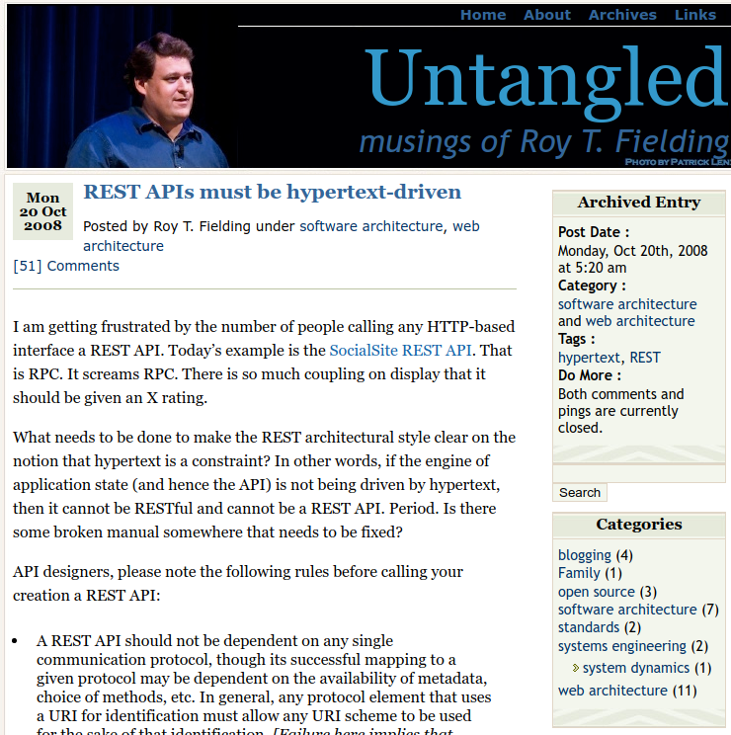
RESTful-ness
"When I say hypertext, I mean the simultaneous presentation of information and controls such that the information becomes the affordance through which the user (or automaton) obtains choices and selects actions." - Fielding, 2008

Slide 19
RESTful-ness
"When I say hypertext, I mean the simultaneous presentation of information and controls such that the information becomes the affordance through which the user (or automaton) obtains choices and selects actions." - Fielding, 2008

Slide 20
A New Kind of Service

Slide 21
Analysis Exercise

Slide 22
Models, Messages, and Vocabularies

Slide 23
Models, Messages, and Vocabularies
Models on the Inside
Messages on the Outside
Vocabularies Everywhere
Design Exercise

Slide 24
Models on the Inside

Slide 25
Messages on the Outside

Slide 26
Vocabularies Everywhere

Slide 27
Design Exercise

Slide 28
BREAK

Slide 29
Runtime Service Infrastructure

Slide 30
Runtime Service Infrastructure
Advertising Services
Discovering Services
Health Checking
Discovery Exercise

Slide 31
Advertising Services

Slide 32
Discovering Services

Slide 33
Health Checking

Slide 34
Discovery Exercise

Slide 35
The Adaptable System

Slide 36
The Adaptable System
Evolvable Providers
Adaptable Consumers
The Power of Numbers
Adaptation Exercises

Slide 37
Evolvable Providers

Slide 38
Adaptable Consumers

Slide 39
The Power of Numbers

Slide 40
Adaptation Exercise

Slide 41
Summary

Slide 42
Summary
A RESTful Approach
Message-Oriented Implementation
Discovery Constraints
Emergent Adaptability

Slide 43
A RESTful Approach

Slide 44
Message-Oriented Implementation

Slide 45
Discovery Constraints

Slide 46
Emergent Adaptability

Slide 47
RESTful Microservices from the Ground Up
Mike Amundsen API Academy @mamund

